Slide 1
Document Libraries and Form Libraries

Slide 2
Agenda
Why You Need Document & Form Management
Managing Individual Items
Check-Out and Version Control
Item Approval
Document Sets

Slide 3
Why You Need Document & Form Management
Maintain consistent information company-wide
Avoid data duplicity (duplicate copies)
Replace paper trails with electronic forms
Adhere to business rules for documents
Appropriately classify corporate documents
Isolate specific documents in a library for security
Repair erroneously modified/deleted documents
Notes:
One of the most widely employed Features of SharePoint 2010 is document management. Understanding how SharePoint can help your company manage and secure important corporate documents is essential to becoming a skilled SharePoint business user. Some practical situations that can benefit from document and form management include the following:
Because community-based systems allow many users to simultaneously work with a single set of business data, it is imperative to protect that data from erroneous editing or deletion. If multiple users post multiple copies of the same document to the system without oversight, each copy could be modified in a different manner resulting in inconsistencies.
Hardcopy forms and documents can be cumbersome to manage and store, not to mention extremely difficult to search through for pertinent information. SharePoint libraries reduce paper supply costs while providing search, audit and archiving opportunities for mission critical business documents. Paper corporate forms can be replaced with online XML-based e-forms that can be filled out and submitted electronically then automatically processed through business pipelines via SharePoint workflows.
Information workers can employ document and form management techniques to help correctly qualify corporate documents and isolate those files that require specialized management or security settings. SharePoint site administrators can plan and create separate libraries on the site to support the corporate data taxonomy design.
Despite best intentions, occasionally business information workers may erroneously modify or delete a mission critical document. SharePoint offers salvage capabilities in the way of version control and a user-centric Recycle Bin to revert or restore a document. Because these tactics can be performed directly by the business user document recovery can be accomplished immediately by those who know the data best.

Slide 4
Agenda
Why You Need Document & Form Management
Managing Individual Items
Check-Out and Version Control
Item Approval
Document Sets

Slide 5
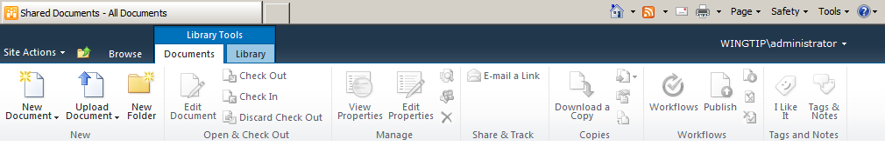
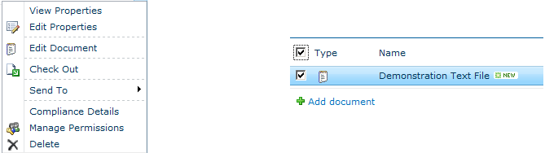
Managing Individual Items
Notes:
While document libraries allow you to store multiple files in a single repository and manage them as a unit, there will still be occasions when you need to work with an individual document at a time. Both the Documents ribbon and a given item’s contextual menu give you the chance to perform tasks against a single document or select group of documents at a time without affecting all of the items in the library.
Working with a single item is perhaps best accomplished using that item’s contextual menu. From this menu you can:
Examine or edit the document’s metadata values.
Open the document itself in the application associated with the item’s file name extension for reading or editing.
Check Out or Check In the document for edit locking purposes (more on this later in this lesson).
Send the document to alternate locations.
Examine the item’s record status for archive or compliance purposes.
Manage the permissions on the individual item.
Delete the item.
If you need to work with a subset of documents from the library but not all of the documents within the library, you can employ the selection checkboxes for the library and check only those items you need to engage. Then use the Documents ribbon to perform a singular task against multiple items simultaneously.

Slide 6
Adding Items to a Library
Notes:
To populate a document library with items, you can either create new items directly into the library or upload existing files from the file system. The Documents ribbon offers icons for both of these tasks.
Creating a New Document will result in the automatic launch of whichever application is associated with the file name extension defined as the default document template on the library’s settings. This assignment is determined by the library designer at library creation or can be altered thereafter. For example, if the library designer set the default document template to a blank Word 2010 document, when you click the New Document icon in the ribbon Microsoft Word will automatically launch and load a blank document template file.
Forms libraries work a bit differently in that their default document template setting is usually programmed to call a specific blank form template .xsn file (if you created the form in Microsoft Office InfoPath). This blank form document will have been previously created by a forms designer. When you click the New Form icon in a Forms library ribbon, the predefined form will appear awaiting completion. Once you’ve filled out the form and clicked Submit, your completed answers to the form will constitute a new item in the Forms library.
You can also populate a document library with a file from the file system by using the Upload Document icon on the Documents ribbon or clicking on the Add document hyperlink in the bottom of the document library’s associated web part. When uploading documents, you can either upload one file at a time or multiple files simultaneously. Using either method, the file’s metadata maintained by SharePoint will need to be populated with values (especially if the metadata column requires a value) either during upload or soon thereafter.
Files that are uploaded from the file system remain on the file system and a copy is placed into SharePoint. This distinction is important, because once a document has been uploaded into SharePoint fellow business information workers should be strongly discouraged from returning to or working with the file copy still resident in the file system. There is nothing in SharePoint that will natively keep the SharePoint library item synchronized with the file system file it originated from.

Slide 7
Single Instance Storage
Microsoft coined this phrase to describe the industry-wide practice of only storing a file once in the system.
SharePoint offers various mechanisms to help achieve data consistency, such as:
Navigation tools to a given library on a specific site
Item-level permissions to open a library item to users beyond those who actively participate on the site.
The Hyperlink to another document content type
Item Contextual Menu’s Send-To option
Notes:
Single Instance Storage is a phrase Microsoft adopted long before SharePoint 2010 to describe the practice of maintaining only a single copy of data in a repository. The idea is to store one copy and make it available to multiple users simultaneously.
Single instance storage assures the data’s integrity by eliminating the need to synchronize with duplicate copies. Imagine a document in the HR Benefits document library titled 401KInstructions. Though the document is stored in a library on the HR site, it gets read frequently by users who do not work for the HR department. As long as those non-HR employees have permissions to the HR site and, more specifically, the HR Benefits library, they can utilize the navigation tools in SharePoint to browse to the 401KInstructions document.
But imagine that some of those readers have no permissions to access the HR site or the HR Benefits library itself. How could you deliver the 401Instructions document to them? If you answered that a second copy of the 401KInstructions document could be uploaded to a library on a site those readers actually do have access to, you would be violating the principle of single instance storage. By keeping multiple separate, autonomous copies of the document in SharePoint you are doubling the storage space needed and potentially allowing changes to be made to one of the 401KInstructions documents that does not similarly get performed on the second 401KInstructions document. This would cause inconsistencies between the two copies and could result in misinformation and ill advised decisions.
Instead, SharePoint offers the ability to set item level permissions on the original 401KInstructions document in the HR Benefits library. Users with no permissions to the library itself or the site the library is located on can still access the individual 401KInstructions document by entering its URL into their browser (they just can’t hierarchically navigate to it by browsing the site). To make it easier for those users, you could add a link item into a Links list on a site those users can access and have the hyperlink resolve to the 401KInstructions document’s URL.
Another option is to employ the SharePoint content type called Hyperlink to another document. A Library or Site administrator must associate this system-supplied content type with one of the libraries to which the non-HR users have at least the add item permission. Those users may then add a new item to their library that merely points to the original 401KInstruction document’s URL. For all intents and purposes, the new item in their library will look similar to a document item. The big difference is that while regular items in their library actually contain files, this hyperlink item will simply point to a file in another library. Of course, this would require that the 401KInstructions document in the HR Benefits library bear at least a Read permission assignment for the non-HR users.
If single instance storage is not a viable option, users can take advantage of the contextual Send-To option on the 401KInstructions document in the HR Benefits library. With the Send-To option, users can choose to download a copy of the document (to take it offline) or send a copy of the document to another library or a document workspace site. And though sending the document to another library or a workspace would technically violate single instance storage, inconsistencies are mitigated because there is a configuration setting that can create a bond between the original 401KInstructions document in the HR Benefits library and the second copy. Changes made to a second copy of the document in a document workspace can be pushed up to the original file. And changes made to the original file can be pushed out to additional copies residing in other libraries.

Slide 8
DEMO
Working with SharePoint 2010 Document Libraries
Notes:
In this demonstration, your instructor will illustrate:
The process of adding an item to a library.
The options available on individual library items via the item’s contextual menu.
The process for sending an item to an alternate location.
The concept of single-instance storage and how to accomplish it.

Slide 9
Agenda
Why You Need Document & Form Management
Managing Individual Items
Check-Out and Version Control
Item Approval
Document Sets

Slide 10
Check-Out and Version Control
Document management features that control edits made to items
Both are optional endeavors
Check Out can prevent conflicting changes to an item
Version Control can prevent erroneous changes to an item
Notes:
SharePoint offers features to help protect your documents and forms from being erroneously edited or corrupted. The document management feature called Check-Out is a locking mechanism for preventing a library item from being edited by more than one user at a time. Version Control, on the other hand, retains previous renditions of library items for comparison or restoration purposes.
Neither Check-Out or Version Control is required on a library. If invoked, Check-Out can potentially decrease productivity as multiple users will have to wait for the current editor to finish making their changes to the document or form before another user can open that item for edit purposes. Check-Out does not prevent read access to the item, just edit access.

Slide 11
Check-Out
Locks an item for edit purposes
Limited to a single user
Can be enforced on a library
Notes:
One of the dangers of allowing multiple users simultaneous access a single document or form in SharePoint is handling edits. When multiple business users just want to read the file at the same time, concurrent access is seamless. But when two or more users wish to edit a library item at the same time but in different manners from one another, multiple user access can become a challenge.
SharePoint offers a document management feature that will lock a given library item for editing purposes. The feature holds exclusive editing privileges for the user account who checked the item out of the library…regardless of actual permission settings. A library item can only be checked out by one entity at a time, thereby assuring that only one user at a time can be editing the document. Other users retain only the ability to read the item until the editing user checks the document back in to the library.
Any business information worker with the Edit Items permission to the library has the ability to check out an item. In fact, the library designer can configure a setting on the library that enforces check out behavior so that the library won’t allow its items to be edited until they are checked out first.
Once the item has been checked out, an indicator is added to the item’s icon in the Type column. Library visitors can hover their mouse over the Type icon to see a tool tip appear near their cursor that divulges the user name of the editing user who has the item checked out.

Slide 12
DEMO
Document Library Document Management
Notes:
In this demonstration, your instructor will illustrate:
The process of identifying library items that have been checked out.
The effects of having a checked-out item forcibly checked back in by someone other than the editing user.

Slide 13
Version Control
Set by the library designer
Retains previous renditions of library items
Tracks editing lineage
Allows item to be reverted back to a previous version to alleviate erroneous edits
Notes:
Another document management feature offered by SharePoint is the ability to keep versions of library items. Version control is helpful for tracking the changes made to documents and forms by various editing users. In fact, if a business information worker makes an edit to a library item that is not appropriate, the item can be restored to a previous version without the need to restore a backup copy.
Version history is a library level setting that can be enabled by any user that has at least the Design permission to the library. When the library designer or site administrator engages version history on a library, each existing item receives a major version number of 1.0 that can be seen using the contextual Version History option available both on the Documents ribbon and in the drop-down item menu. Thereafter, new items added to the library may initiate as either a major version number of 1.0 or a minor version number of 0.1 depending on how the library designed set up version control.
Major versions of items receive whole version numbers (1.0, 2.0, etc.) and are considered published and therefore are available to anyone who has Read permission to the library. However Minor versions, sometimes called Draft versions, receive fractional numbers (0.1, 0.2, 1.1, 1.2, etc.) and have additional optional security settings that can be configured by the library designer to hide them from anyone who does not have either the Edit Items permission or the Approve Items permission to the library. Minor versioning is not mandatory in version control but can be helpful on libraries where the items tend to go through periods of work in progress during which the unfinished edits should only be exposed to the editing user or to a small group of users who are working on the document.
Business users who have the Edit Items permission can choose to restore a previous version of an item (major or minor) back into the library. The previous rendition will replace the current rendition of the item in the library, thereby setting the item back to a past adaptation of its contents but with new, current metadata values in the Modified By and Modified (date) columns. The version that got replaced will move into the Version History of the item as the most recent past version. Past versions that are no longer needed should be deleted from Version History to maintain acceptable library size.
NOTE: Any change to a library item, even if just a metadata value change, is considered a new version of the item. Be careful not to unnecessarily open items in a version controlled library for edit as this changes the modified metadata and generates a new version. Version control increases a library’s storage needs and can grow the library beyond acceptable size quickly if not properly maintained.

Slide 14
DEMO
Document Libraries & Version Control
Notes:
In this demonstration, your instructor will illustrate:
The library setting for Version History as set by a library designer or site administrator.
The effects of version control on existing and new library items.
The process of viewing version history, restoring previous versions and deleting previous versions of library items.

Slide 15
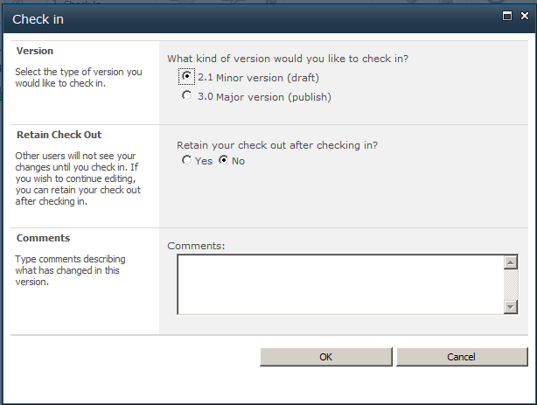
Check Out and Version Control Together
Notes:
When a library designer has employed both the Force Check Out and Version History library configuration settings, business information workers will experience a particular sequence of events when they edit library items.
First and foremost, remember that SharePoint 2010 is security trimmed so users who only have the Read permission to the library or item will not receive a ribbon or drop-down menu choice to Edit Item. But users who have the Edit Items permission will see the choice to make edits in the Document ribbon and/or contextual item drop-down menu. They may notice that the option is entitled Check Out & Edit, indicating the item cannot be edited without checking it out first thanks to the Force Check Out library setting.
When the editing user has completed their work and is ready to check the newly renovated item back into the library and release their edit lock on it, the Check In process produces a dialog box similar to the one on this page. Though the box title is Check In, the fields have more to do with Version Control than with the Check In process itself. When minor version control is engaged on a library, checking your edited document back into the library forces you to decide whether your edits represent a minor or a major version change. Whichever you decide, you are given the opportunity to retain your check out lock after these edits are checked back in to the library. Choosing the Yes radio button on the Retain Check Out option would be appropriate if you were trying to check back into the library a “block of work” (or changes) you had made to the document that you wanted other readers to begin seeing, yet you weren’t quite finished editing the document. Lastly, you are given the opportunity to add version comments to your new version of the document, which can help other editing users determine what is new or important about your version of the item.

Slide 16
Agenda
Why You Need Document & Form Management
Managing Individual Items
Check-Out and Version Control
Item Approval
Document Sets

Slide 17
Item Approval
Content Oversight
1 or Multiple Approvers
View Item Approval Status
Singular, Parallel, or Serial Approval Streams
Notes:
In many community based platforms, allowing multiple users to contribute items to the system raises a business need to oversee contributions and edits to those items. Sometimes security requirements dictate that someone verify new edits or items are not exposing confidential information to the wrong audiences. Another example may be a project team working together on a document bound for distribution to the public that requires someone from the marketing and legal departments sign off on the final version to assure the correct message is being presented.
SharePoint 2010 includes approval features that can be leveraged to satisfy business needs for approving items and edits. These features offer:
Content Oversight: business users can be deemed Approvers over certain items, folders or libraries
1 or Multiple Approvers: support for multiple approvers allows additional multi-layer oversight
Singular, Parallel, or Serial Approval Streams: approval can be required by one identified approver, by one of multiple potential approvers, by multiple approvers in any order, or by multiple approvers in a structured sequence
View Item Approval Status: readers of the library can view the current approval status of a document depending on their permission

Slide 18
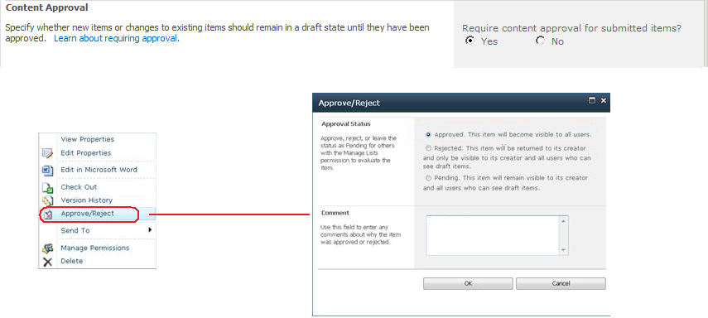
Content Approval Library Setting
Notes:
If you only require an easy approval process on a library that keeps all new items and new edits in a Pending state until one overseer deems the new content worthy, SharePoint offers a simple solution in the form of a library configuration option called Content Approval.
The Content Approval library setting has only two states: off or on. By default, every library’s Content Approval setting is turned off, but a library designer or site administrator can change the Content Approval radio button choice from the default No to the radio button Yes to turn on this library setting.
Once engaged, Content Approval will catch all new items and edits from that point forward and put the item into a Pending status awaiting approval or rejection. Items that existed in the library prior to Content Approval being turned on will not be affected. Who can approve these new items and edits? Any library user who has been granted the Approve Items permission to the library, folder or item. If there are going to be several users with the authority to approve items, your site administrator may consider creating an Approvers SharePoint group to collect those users as members of the group then grant the Approve Items permission to the group instead of granting the permission to each individual user.
The Content Approval library setting is a single approver solution. It only takes one user who has the Approve Items permission to Approve or Reject the item in order for the item to move out of Pending status. If multiple users have been granted the permission, it does not matter which of them commits the Approve or Reject action.

Slide 19
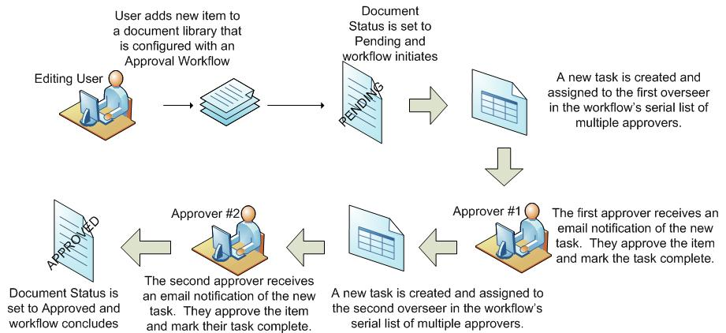
Approval Workflow
Notes:
If you only require a more complex approval process on a library than the singular approval solution offered by the Content Approval library setting, your library designer or site administrator may create an approval workflow.
Workflows in SharePoint 2010 help to automate business processes. An approval workflow can reflect the chain of events that need to happen for a newly submitted item in a library to move from Pending status to Approved status so that all readers can see the new item. The workflow above is a very simplistic example, but you can see that when multiple approvers are required to sign off on a document in a specific order, a workflow can be used to implement a series of events (known as a serial approval stream) where one approver at a time gets the opportunity to review and either approve or reject the document.
Workflows can also be used to enforce parallel approval streams where multiple approvers must all approve the document in order for its status to go from Pending to Approved, however there is no specific order of approvers required. While all must eventually approve the document, who approves it first and who approves it second after that person is irrelevant.
If your site administrator decides to delegate to you the authority to create workflows, you should consider attending additional training on workflows before attempting to create these automated business routines yourself. Creation of workflows falls beyond the scope of this course.

Slide 20
Agenda
Why You Need Document & Form Management
Managing Individual Items
Check-Out and Version Control
Item Approval
Document Sets

Slide 21
Document Sets
MOSS 2007 treats documents as atomic & not linked to other documents
SharePoint Server 2010 introduces document sets, or a collection of documents, spreadsheets, presentations, etc. that make up a single work product
Metadata exists on individual items and the set as a whole
Notes:
The Document Sets feature is a site collection features that is not activated by default.
Document sets pull multiple items together to create a single work product.
Each item is seen as an individual item, but the whole set can be versioned, participate in a workflow or downloaded.
A document set can contain a collection of documents of different types.

Slide 22
Document Sets
Each document set has:
List of available content types allowed within it
Default content automatically added to the set
Can create shared columns (defined in document set’s content type) that are pushed down across all content in set
Welcome page acts as the homepage for doc sets
Customizable Web Part Page displaying the document set’s properties
Notes:
A Document set is a content type that contains other content types, so a document set can only be created on a document library that is content type enabled.
The Document set content type is represented as a folder.
The Welcome page is a Web Part page that can be customized. From here you can manage the properties of the document set and upload documents using the buttons on the ribbon.
Content in shared columns is pushed down to each item in the set.

Slide 23
DEMO
Document Sets

Slide 24
Summary
Why You Need Document & Form Management
Managing Individual Items
Check-Out and Version Control
Item Approval
Document Sets

